Slide 1

Mohs10 Selenium with Java Hybrid Framework

Slide 2
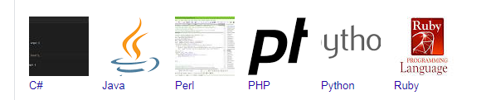
Selenium Supporting Environment
Operating Environment - MS Windows, Linux, Apple OX
Programming Languages:
Application Environment – Web Based and Mobile Based web applications which has web forms.

Slide 3
Advantages
The Hybrid-Driven Testing pattern is made up of a # of reusable modules /function libraries are developed with the following characteristics in mind:
Maintainability – significantly reduces the test maintenance effort
Reusability – due to modularity of test cases and library functions
Manageability – effective test design, execution, and traceability
Accessibility – to design, develop & modify tests whilst executing
Availability – scheduled execution can run unattended on a 24/7 basis
Reliability – due to advanced error handling and scenario recovery
Flexibility – framework independent of system or environment under test
Measurability – customizable reporting of test results ensure quality.

Slide 4
Why Hybrid Testing?
Eg. We want to test the login system with multiple input fields with 1000 different data sets.
To test this, you can take following different approaches:
Approach 1) Create 1000 scripts one for each dataset and runs each test separately one by one.
Approach 2) Manually change the value in the test script and run it several times.
Approach 3) In this case, the keywords as well as the test data are externalized. Keywords are stored in a separate Java class file and test data can be maintained in a Properties file or an Excel file.
In the given three scenarios first two are laborious and time-consuming. Therefore, it is ideal to follow the third approach.
Thus, the third approach is nothing but a Hybrid - Driven framework.

Slide 5
Base Class
Page Layer
Test Layer
Common Utilities
Test Data / Config
Logs & Report
Browser, Plug-in & Language
Create TestNGsuite.xml
Update Dependencies(POM.xml)
Git Repositories( Push)
Continues Integration(Jenkins)

Slide 6
Key Components in this Framework
Config. Package for Constants
Hybrid with reusable components and classes
Extent Report
Simplified script writing
Cross Browser Testing
New Selenium Customized functions
Maven for Jar files version control
Created dependencies for Jar files using Maven
Git configuration
Jenkins Integration
Ready to use Frame work

Slide 7
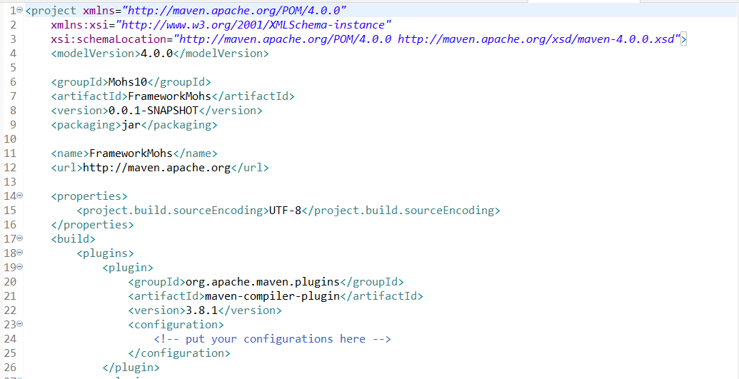
Selenium Framework Integration with CI Tool
MAVEN Configuration

Slide 8
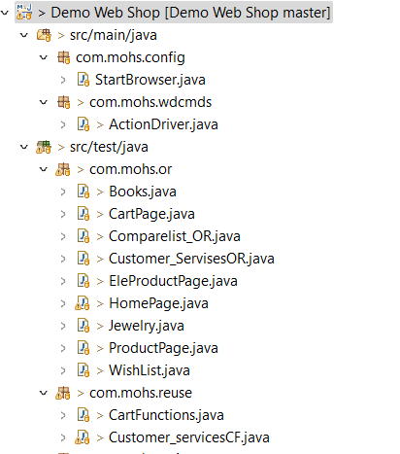
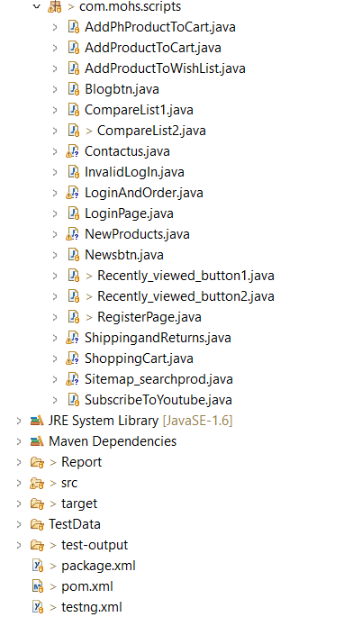
Project Structure
Page Object Model is a design pattern to create Object Repository for web UI elements.

Slide 9
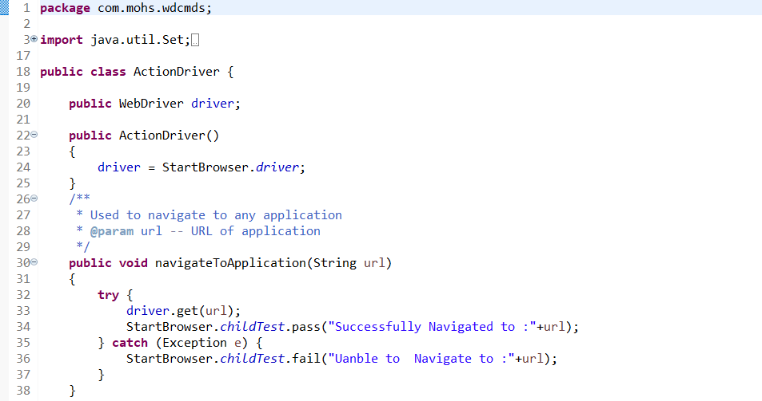
Action Driver Package
ActionDriver class contains all generic functions/ customized functions like clicking on an element, verifying element or text, Waitforelementpresent, mousehover and rightclick etc.

Slide 10
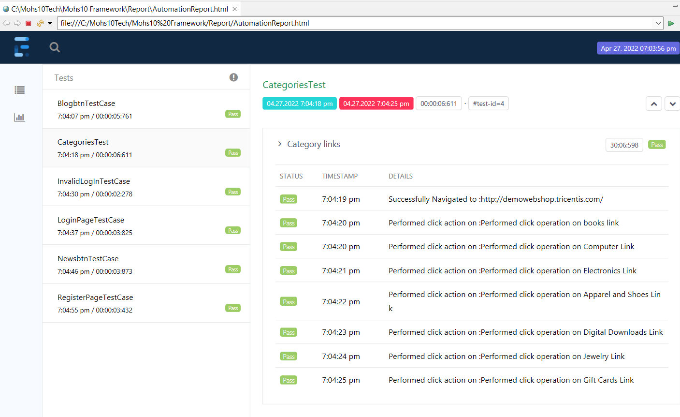
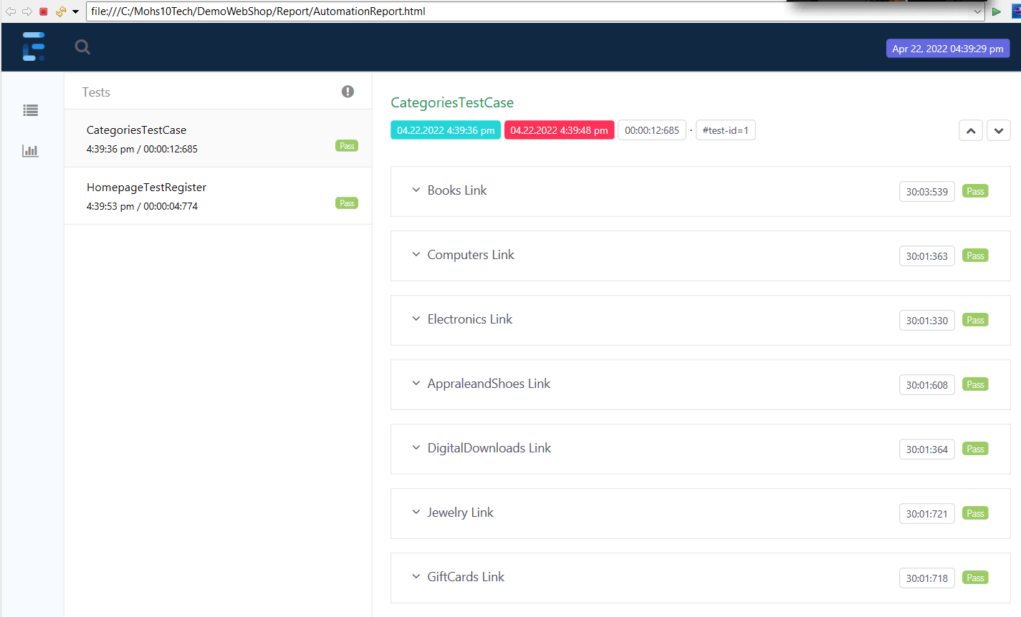
Reports
Reports is being used for reporting purpose(HTML Reports)

Slide 11
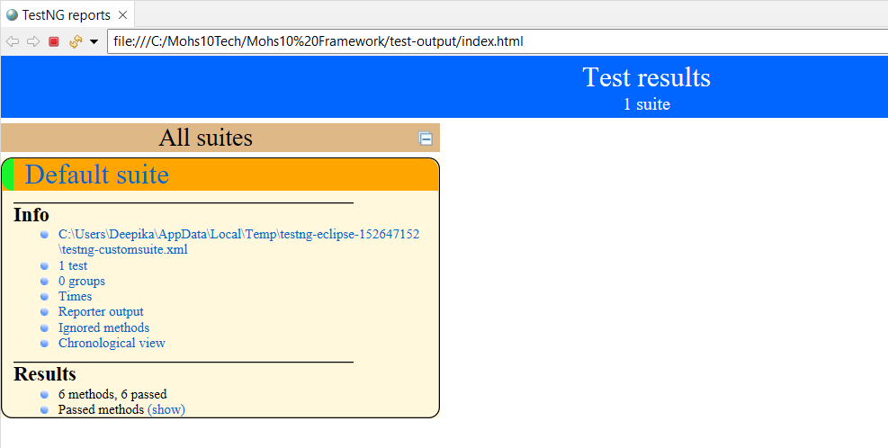
Reports
TestNG Reports

Slide 12
Why Mohs10 Technologies
Technologies Use
Compatibility
Functional Testing
Capabilities
AI/ML Testing
High class service
Mobile Testing
Reliability
Performance Testing
Expert Team
Security Testing

Slide 13
Thank You…!
Presented by
Deepika

